Slide 1
Customer Churn Analysis
By Martin Mwiti Mbae

Slide 2
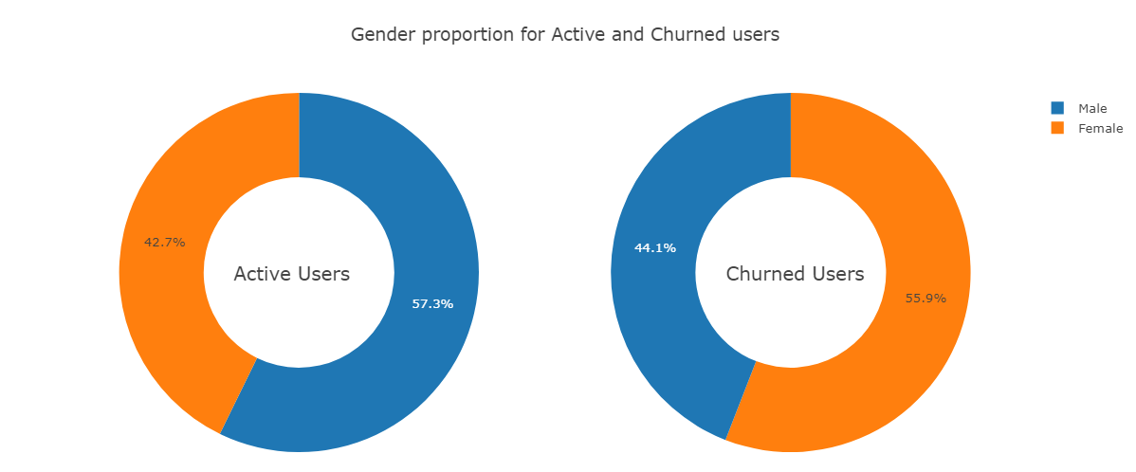
Active VS Churned
60% of our churned customers are female, this is not necessarily a bad thing because females constitute 57% of our current customer business.

Slide 3
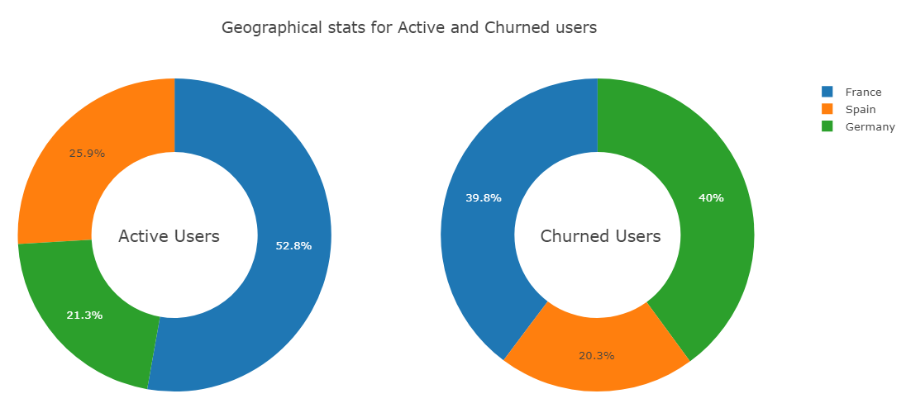
Active VS Churned
40% of our churned customers comes from France, currently France constitute 53% of active users. Germany constitute 40% of churned users. This is not a good thing because they now constitute the lowest percentage of active users.

Slide 4
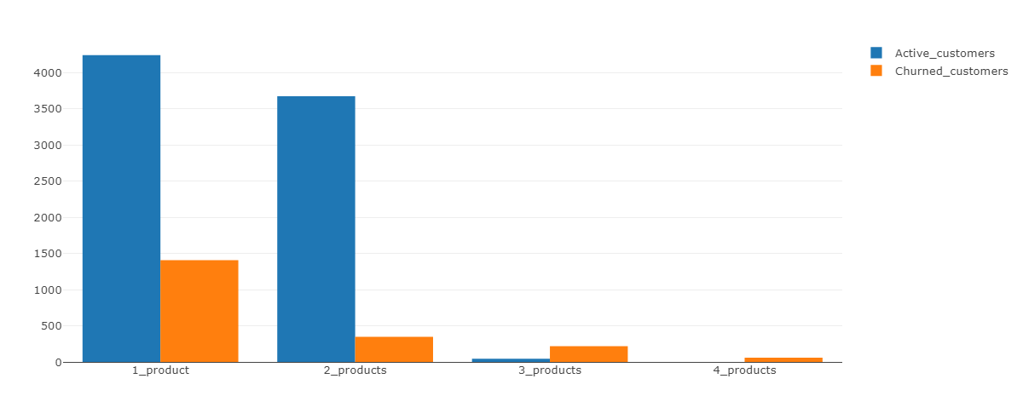
Number of Products stats(Active vs Churned)
By offering one or two products, we retain more customers compared to those who churn. If we offer more than two products, we face more churned than active customers.
4242
3675
Number of Users
1409
46
348
220
60
Number of Products

Slide 5
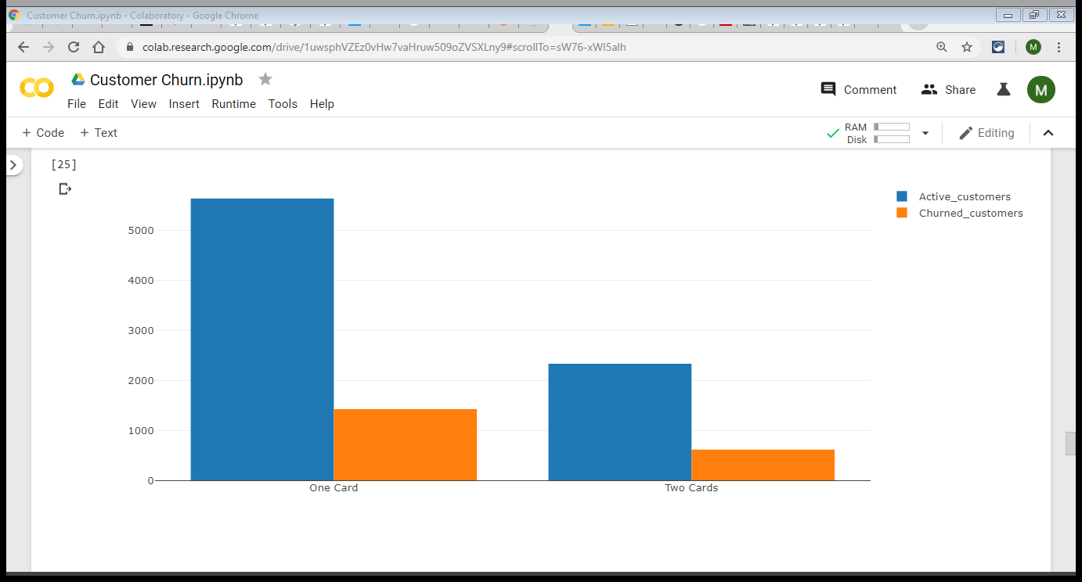
Number of Cards stats(Active vs Churned)
All of our customers have at least one card. One card constitutes the majority of customers. This does not mean providing two cards is necessarily bad.
5631
2332
1424
613

Slide 6
Facts Summary
Female constitute the largest proportion of both Active and Churned customers.
Customers with one or two products tends to stay with us longer.

Slide 7
Conclusion
Although i have performed ML and ANN on this dataset, the data provided is not enough to justify using predictive modeling. I would need customer behavior over time such as:
1. Where were they before joining the bank?
2. When did they join us?
We could extract features and throw it into an ML or ANN model but since we only have one tuple per customer, building this classier isn't really helpful given this data.

